Slide 1
Research institute for statistics and information science (RISIS)
20-Nov-2025, GSEM faculty meeting

Slide 2

I’ll make use of the following color code:
Research in Stats
Research in Info Science
Teaching

Slide 3
PAST
Information Science Institute
(ISI)
Reseach Center for Statistics
(RCS)
Research Institute for Statistics and Information Science
(RISIS)
Jan 2024
Jan. 2024

Slide 4
Present
three members of RISIS won GSEM teaching awards
Teaching
Bachelor program at GSEM & GSI (& CUI & Law): Maths I, Maths II, Prob, Stats, Stat Modeling, Prob and Stat Learning, Business Analytics, Numerical Methods, Statistical literacy and data skills for the SDGs, Algorithmique appliquée, Communication Networks, Open Science, Statistical Literacy and Data Skills for the SDGs, Comprendre le numérique (cours transversal), …
two MSc programs (MaBAn & MaStat (& CUI)): Machine Learning, Time Series, Applied Bayesian Analysis, Modern Flex Regression, Analytics Consulting, Algorithmics and Data Management, Crowdsourcing and AI, Mobile Computing…
two Ph.D. programs (Stat and Info Science)
one interdisciplinary certificate program (CCSA)
two summer schools
one course in executive program
Three RISIS members won the GSEM teaching awards in 2025

Slide 5
Present
Research
- fundamental and applied statistics, machine learning (ML), analytics, and information science, establishing theory & methods that integrate statistics, ML, data analytics within various disciplines (economics, finance, management, medicine, informatics…)
- through collaborations with national and international research institutions, RISIS ensures that its innovations translate into practical applications
- RISIS members act in various cantonal, national, and international boards, like the Federal Commission for Statistics and FENStatsS (Federation of the European National Statistical Societies), and co-initiated and co-authored the Swiss Data Literacy Charter.

Slide 6
Present
Research
Publications (2024-2025): commitment to high quality

Slide 7
FUTURE
Goal: RISIS will sustain its role in research and teaching, it will keep working on theoretical and computational aspects of statistics, machine learning, data and information science, while enhancing its teaching tools
How: RISIS will foster interdisciplinary collaborations (GSEM, FPSE, Faculty of Science, Faculty of Medicine, BioTech Campus, GEM, Lusenti Partners, Nestlè, OFS); RISIS will strengthen connections between statistics, econometrics, machine learning, informatics, and data-driven science, while adapting its educational offer to align with evolving industry and academic demands

Slide 8


Magnifying the RISIS
Let’s have a closer look via a magnifying glass
and illustrate RISIS:
research and teaching activities,
projects of interest,
available skills,
tools or resources and,
other things that might be relevant to other institutes
(K. Preuschoff)

Slide 9
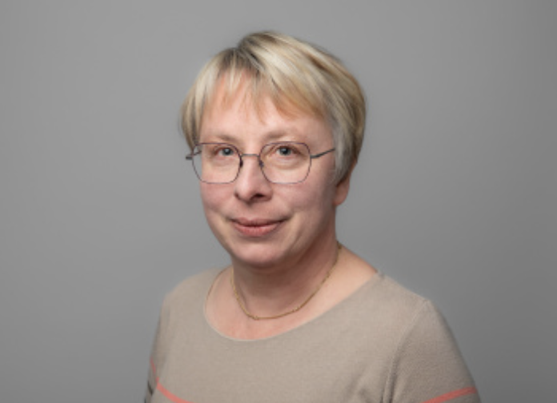
Eva Cantoni
Research: Modelling of and inference on datasets with complex structures: - univariate and multivariate data (often counts, but not only) with excess of zeros - random effects - robust alternatives
Keywords: ZIP and hurdle models, mixed models, GLM/GAM/GAMLSS models, single index models, latent variable models (GLAM), spatio-temporal models, state-space models. Applications in several fields, notably in ecology and medicine: “I like interdisciplinary collaboration and the challenge of knowledge transfer to other fields. I’m sensitive to dissemination, including software. If you have such structured data and want to collaborate, do not hesitate to reach out.” Teaching: Bachelor + Master: Prob & Stat Learning, Stat Modeling, Modern Flexible Regression; keen on pedagogical innovations (e.g. flipped class, use and assessment of (gen)AI for complete statistical analyses by students (MA)); won GSEM price for innovation in teaching.

Slide 10
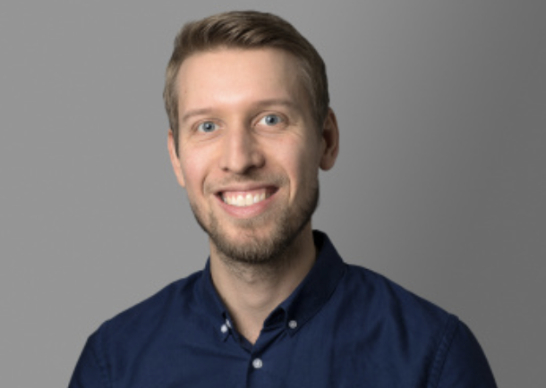
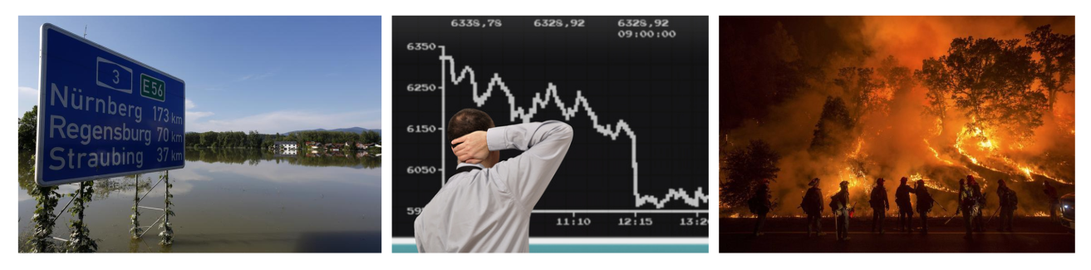
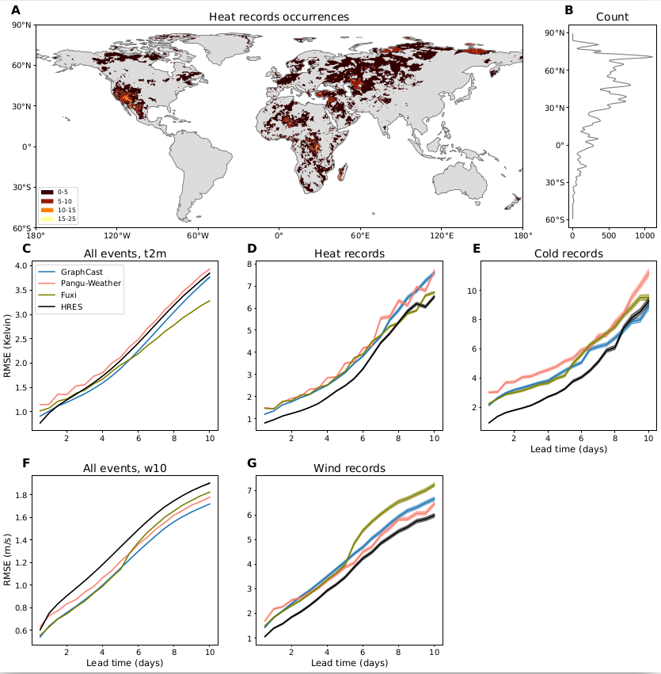
Sebastian Engelke
Research:
- Analysis of low-probability high-impact events (e.g., financial crises, floods, bush fires)
- Focus on learning graphs/networks representing dependence between different risks factors
- Applications range from systemic risks in bank networks to risks of climate extremes
AI weather and climate models: (a) we have infrastructure (GPUs) to run and finetune large-scale AI weather models (b) evaluate these models and compare them to traditional physical models; (c) focus is on extreme weather events and how well AI methods extrapolate.
Media coverage: https://www.bloomberg.com/news/newsletters/2025-09-01/ai-models-struggle-at-forecasting-extreme-weather-events?srnd=undefined
Notes:
"My research develops statistical methods that can be applied in several core areas within GSEM. The extreme value models for networks and graphs can be used to model risk of financial assets, banks, or climate extremes. The AI weather and climate models we study can be linked to impact models or to forecasting of renewable energies, for instance.
The line of research on AI weather models generates a lot visibility for GSEM, since I have been interviewed for the New York Times, Bloomberg and Tagesanzeiger.
My Master class on "Machine Learning" is attended by more than 70 students across institutes (and faculties) and introduces basics of AI methods. The "Advanced Topics in Machine Learning" covers reinforcement learning and large language models. Both classes thus contribute to the focus on AI in GSEM."

Slide 11
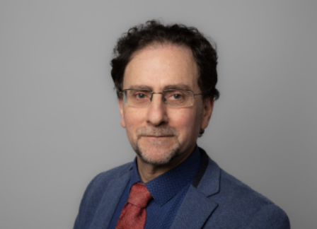

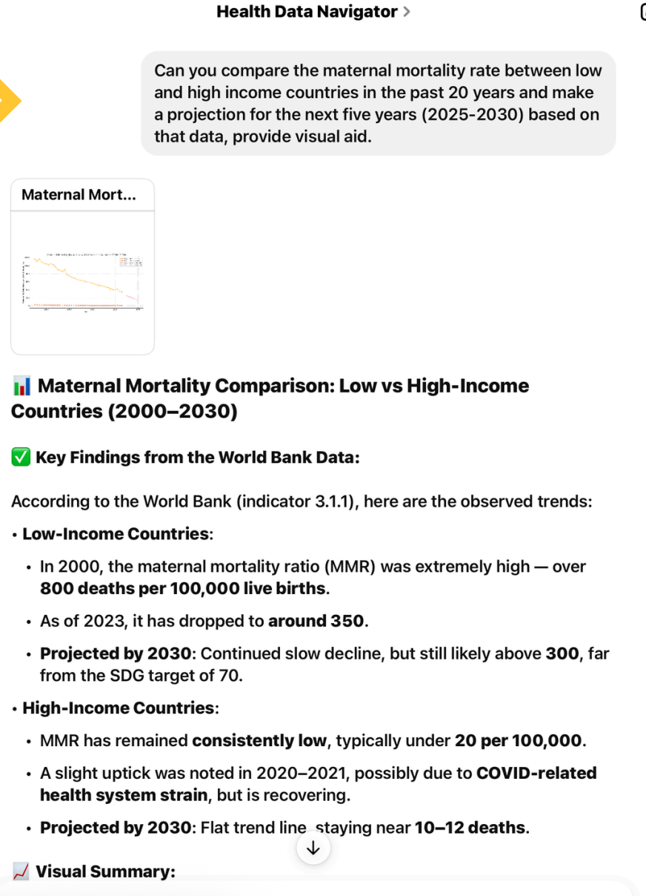

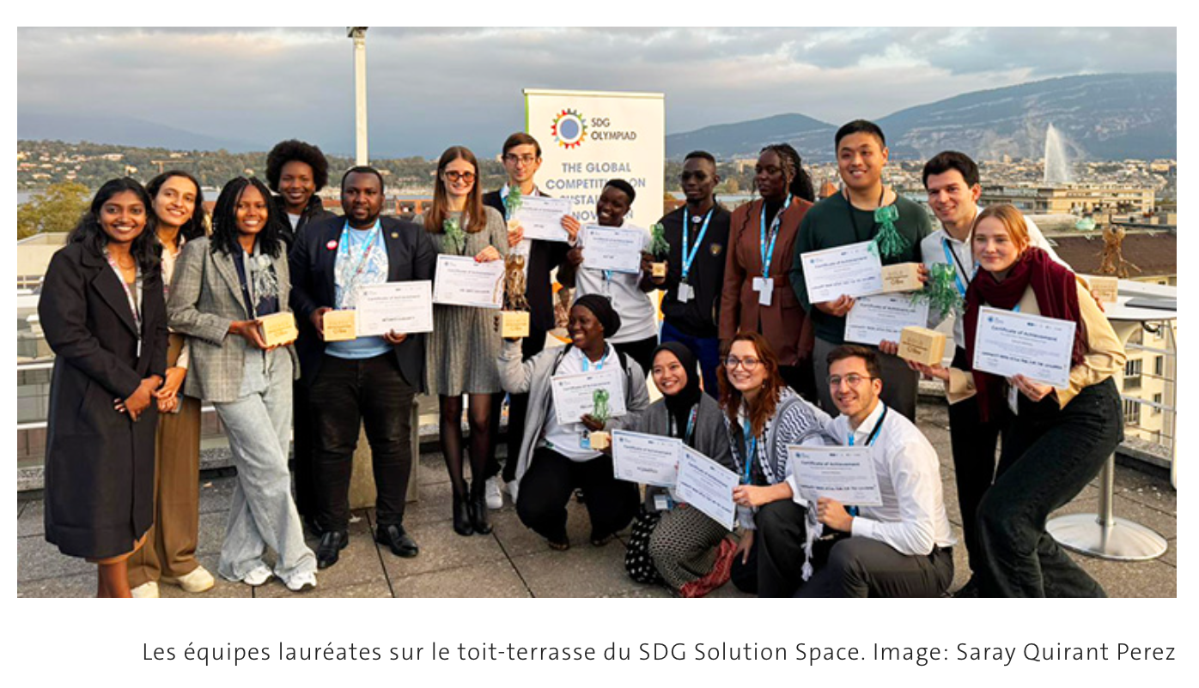

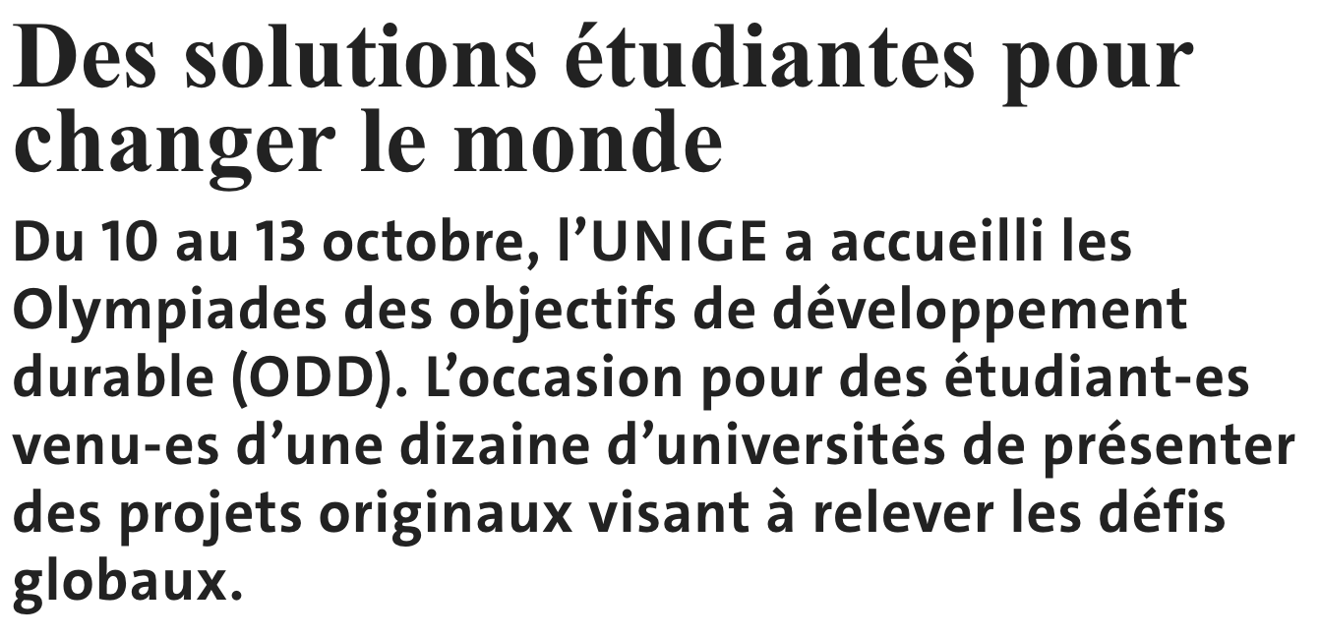
Francois Grey
Research and Teaching: Citizen Science (CS) for Sustainable Development Goals (SDG)
Student-Led Innovation: Prototyping an SDG chatbot
Student-Assisted Research: Preparing data for the chatbot
High-Impact Publication: Documenting the results
Conference paper accepted for ECSA 2026 Conference in Oulo, Finland, 2-7 March 2026 “Innovation management for Citizen Science : what we've learned from the SDG Olympiad”
Article to be published in inaugural issue of this new Nature journal in January 2026:
Citizen science is now essential for official statistics. D. Fraisl, L. See, S. MacFeely (OECD), I. Moorthy, G.-S. Ulrich (Federal Statistical Office of Switzerland), O.Seidu, F. Grey, S. Schütz & I. McCallum.
Part of EU project ALBATROSS
Practical Application

Slide 12
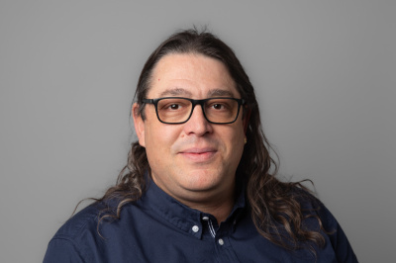

Diego Kuonen
Activities at UNIGE and outside include:
- Founding Director of the Master of Science in Business Analytics and director of CCSA
- Since 2001, CEO at Statoo Consulting
- Current main job: “Trusted Strategic & Tactical Advisor” in the field of data and analytics to executives
- Credo: bridge the gap between professional business management practice and academic research
- Won 2023 Søren Bisgaard Award of the Statistics Division of the American Society for Quality (ASQ)
- Member of the Board of Directors at the Digital Law Center, Faculty of Law (since 2020)
- Current topics (in operationalisation and implementation at clients):
Data & Analytics (including AI) Governance (e.g., holistic, human-centric, trustworthy, principles-based, purpose-driven)
Chief Data & Analytics (including AI) Officer as a Service (CDA(I)OaaS)
Data & Analytics (including AI) Product Lifecycle Management
Analytics-ready Data and AI-ready Data (e.g., AI readiness)
Teaching:
Bachelor + Master + Executive program: Business Analytics, Analytics Consulting, Data Quality and Data Collection Strategies -- keen on pedagogical innovations won GSEM price for innovation in teaching

Slide 13
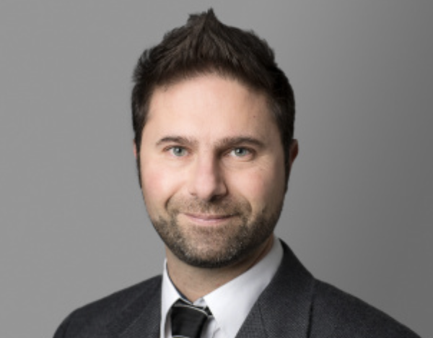
Davide La vecchia
Research:
- Inference on stationary and nonstationary time series
- Learning random fields over nodes/edges of networks/graphs in the presence of latent factors
- Applications: economics (gravity model for flows over the edges) and medicine (EEG, fMRI for time series on nodes)
- Robust Machine Learning via optimal transport (e.g. for Generative Models or Image Analysis)
Teaching: Bachelor + Master: Prob 1, The Statistical Analysis of Time Series, Theoretical Statistics, Teaching Statistics.

Slide 14
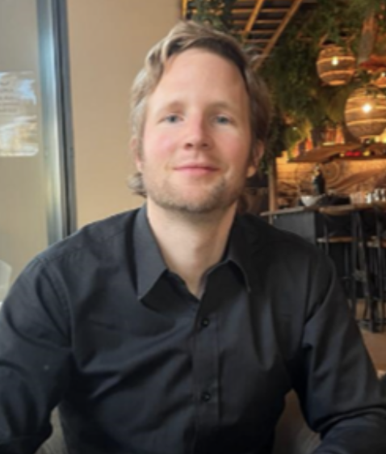
JEFFrey NäF
Research:
- Distributional Prediction/ Random Forests and Kernel methods
Developing specialized Random Forests that learn complex objects, such as the joint conditional distribution of variables of interest given predictors
Distributional Random Forest (DRF) and Causal Distributional Random Forest (Causal-DRF). Both use the concept of kernel mean embeddings to efficiently learn representations of (multivariate) conditional distributions
- Missing Values
Studying and developing best practices in Missing Value Imputation
Theoretical work, treating the problem of missing values as a problem of misspecification and using tools from robust statistics
In general, I am attempting to close the gap between theory and practice in the handling of missing values
- Applications in Marketing Science (Analytics) and Economics
Developing powerful and useful models to predict and analyse the Customer Lifetime Value
Providing professional implementations, such as in the R package CLVTools, to make the models widely useable
Currently, we apply DRF to inflation prediction in joint work with collaborators from the European Central Bank
Teaching: Bachelor + Master: Maths 1, Forecasting with Applications in Business

Slide 15
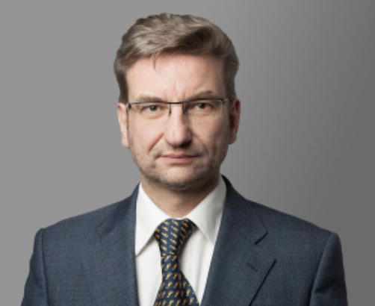
STefan Sperlich
Research:
- Non- and Semi-parametric inference in Generalized Structured Models
“There are certainly different definitions of what that means or implies. In my own research it almost always refers to the approach of imposing a model structure such that you can easily derive interpretable parameters of functions from your estimation methods. ’’
More in detail: (a) additive and multiplicative hazard models for risk and survival analysis (collab with Faculty of Medicine); (b) Data-driven impact evaluation of heterogeneous effects (explain how, for whom, and under what circumstances an intervention works, using a causal graph); (c) Semiparametric factor and gravity models for panel data
- Advanced Inference in Mixed Effects Models
Statistical properties of estimators/tests when heterogeneity is modelled by Random Effects: (a) For estimation in small areas or small clusters (conduct inference on small samples using auxiliary info); (b) Cross factor experimental designs with several fixed and random effects (collab with FPSE); (c) Post-selection ‘selective’ inference with mixed effects models

Slide 16
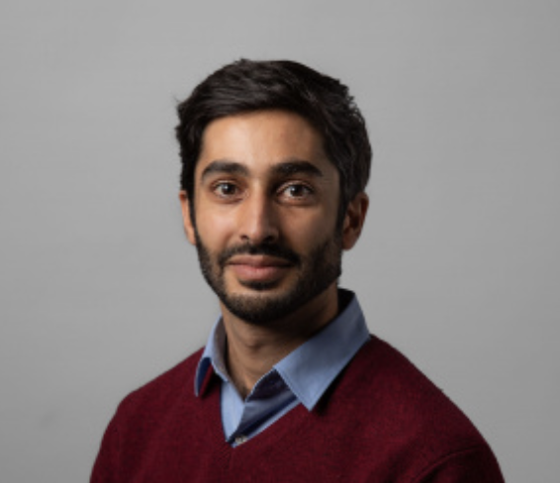
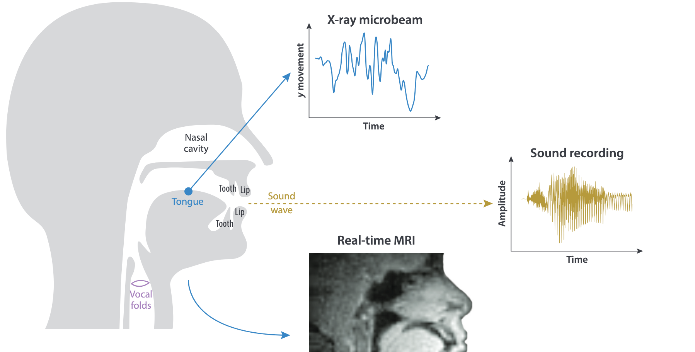
SHahin Tavakoli
Research:
- Functional Data Analysis (FDA): analysis of data that are curves (or images, sounds…)
- Theory & Methods (functional time series, factor models, regression models…). Applications: (neuro-)imaging; phonetics; biophysics; econometrics; genomics; customers analysis based on complete behavioural trajectories (purchase patterns, engagement curves, clickstream journeys); data from sensors and digital systems
Teaching:
Bachelor + Master: Maths 1 (GSEM + BARI), Multivariate Analyis, Applied Bayesian
Analysis --- keen on pedagogical innovations (jigsaw method)

Slide 17
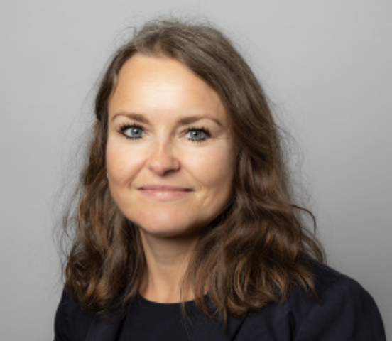
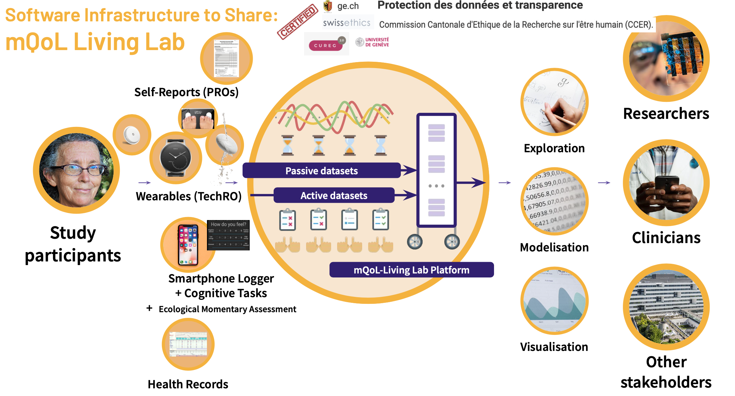

Katarzyna WAC
Research:
- Quantifying Quality of Life via Human-Centric AI Research
More in detail: looking at different domains (Physical health, Psychological aspects, Social relationships, Environment), we precisely define (via human centric methods), accurately capture (via smartphones/wearables), statistically analyze (using methods including AI), and clinically validate (in healthy/diseased populations) 16 (for now) of 24 variables contributing to life quality
Teaching:
Bachelor + Master. How to code (Python, JAVA, C, C++, R, ...); What is a digital service from data to value proposition: stats/ML/AI; communications & networking (client/server); computing & databases, context (PESTEL). How to conceptualize, design, build, validate and pitch a digital service

Slide 18
Thanks

